Slide 1
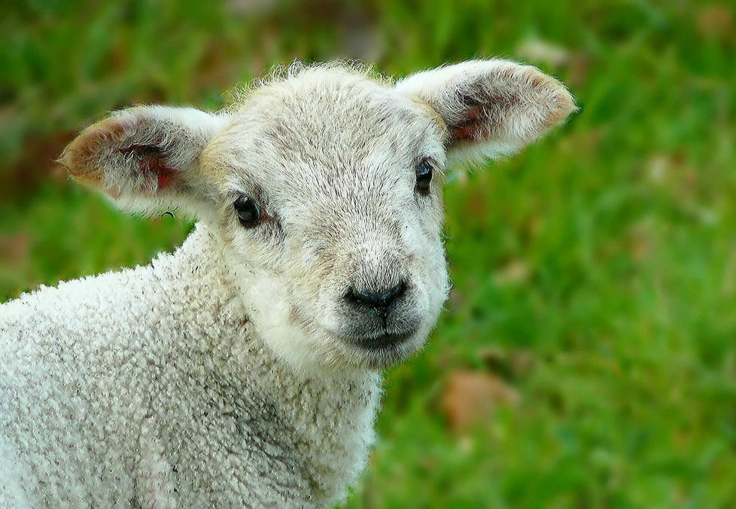

Sunday Toolkit
I am the sheep of the Lord.
There is nothing I shall want.
Sometimes my Shepherd's generosity intimidates me
and every day I need to choose his green pastures
over and over again,
for the dry ground still feels more familiar.
FULL-OF-GRACE.COM

Slide 2
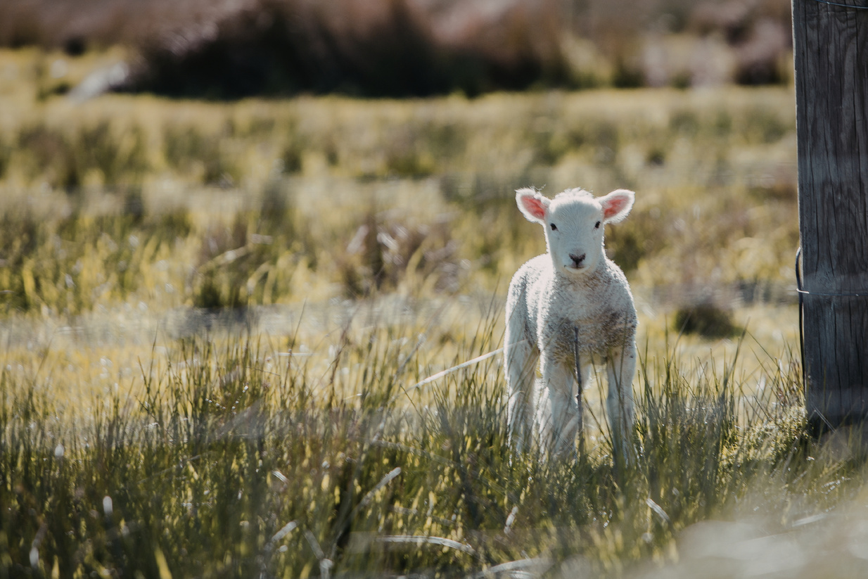
Sunday Toolkit
The Shepherd leads me beside restful waters.
Every morning
I wait at the gate
and listen for the voice
I have learned
not to mistake.
I do not always
follow immediately.
FULL-OF-GRACE.COM

Slide 3
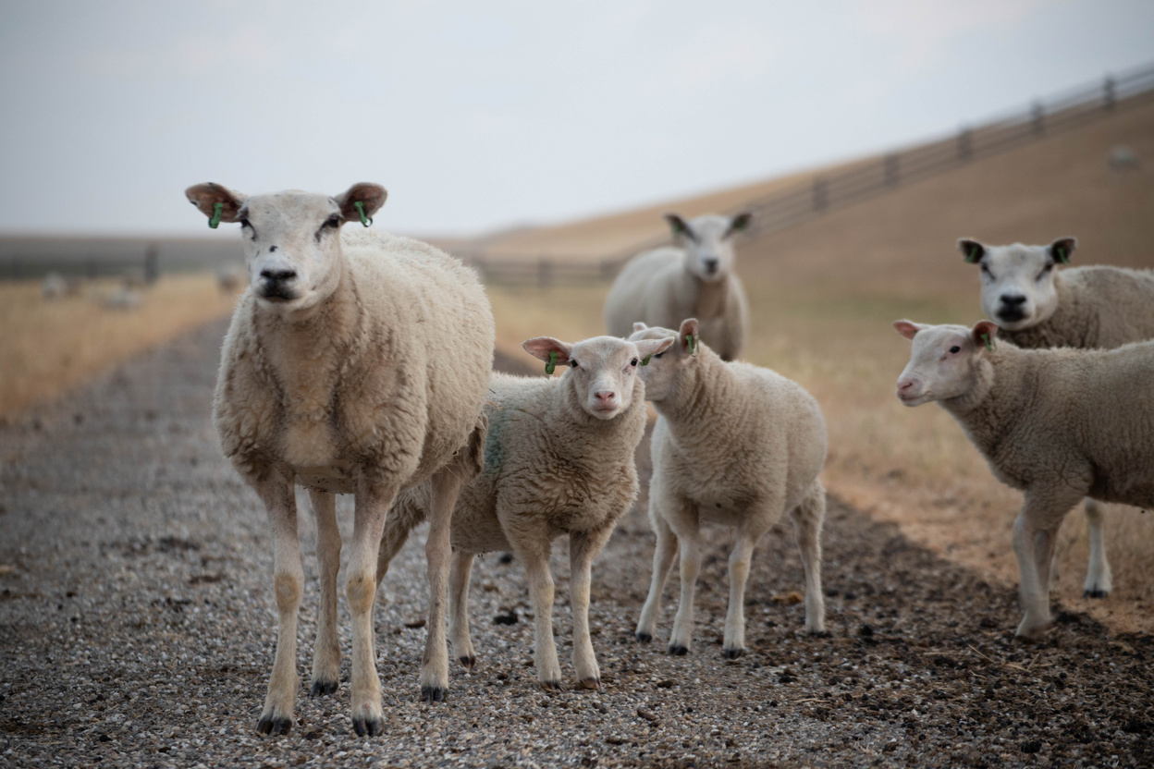
Sunday Toolkit
Sometimes I stand still and let the sound wash over me
before I remember
that I know this voice,
that I have always known this voice,
that it called me by name
before I had a name for myself.
FULL-OF-GRACE.COM

Slide 4
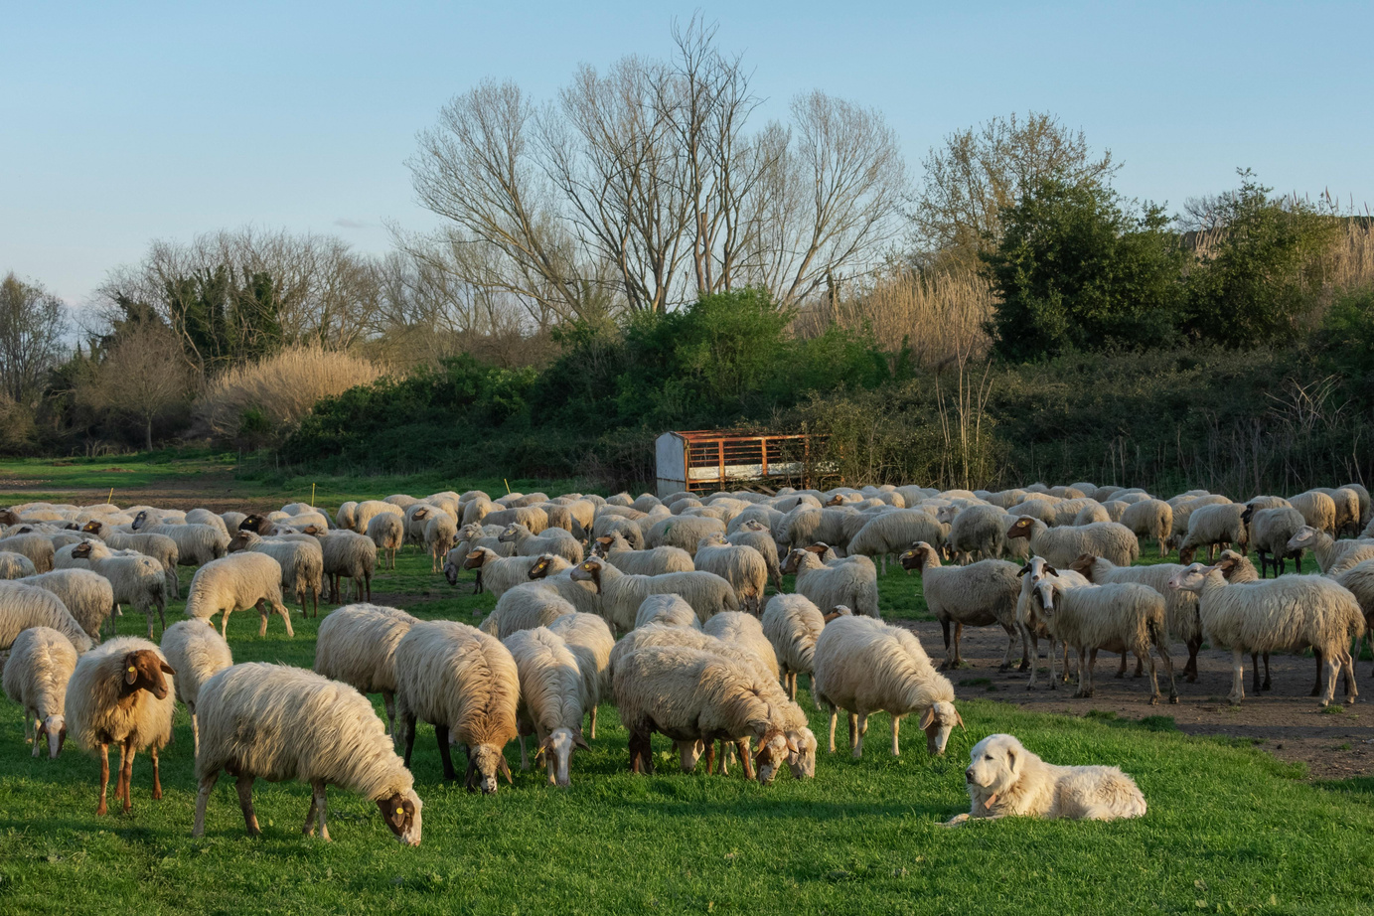
Sunday Toolkit
He restores my soul
– the soul I wore down by wandering,
by eating what did not feed me, by drinking from the streams of confusion.
I let him restore me.
This is harder than it sounds.
Sometimes it feels like a chore.
FULL-OF-GRACE.COM

Slide 5
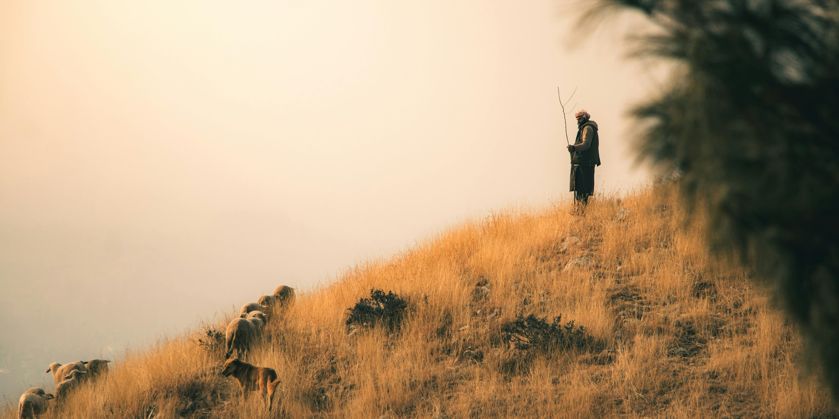
Sunday Toolkit
But He is patient with me
and guides me along right paths.
I have learned to notice when my feet begin to turn away – the small drift, the distraction, the familiar shortcut that leads nowhere I want to be.
FULL-OF-GRACE.COM

Slide 6
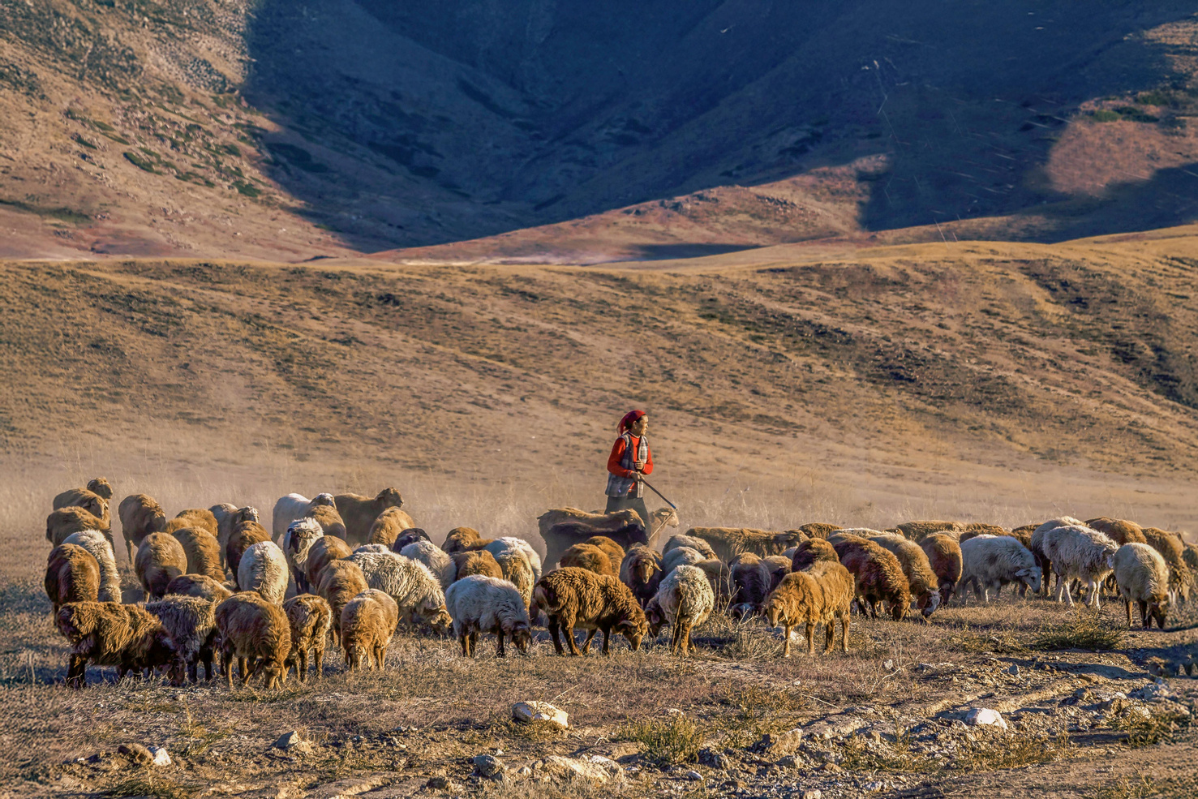
Sunday Toolkit
I come back.
He does not make a ceremony of the return.
He simply continues walking.
FULL-OF-GRACE.COM

Slide 7
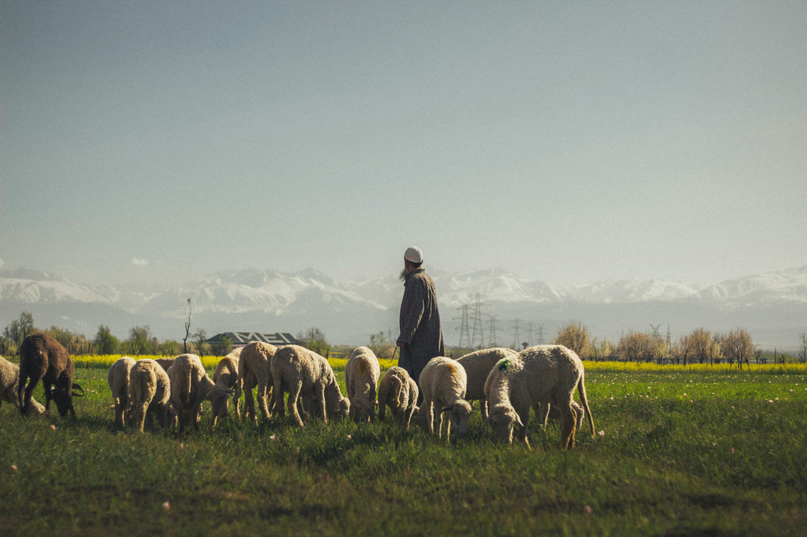
Sunday Toolkit
Even when I walk through the dark valley I am learning not to run ahead of him,
not to lag behind where the shadows gather, but to stay close enough to hear his breathing – that steady presence that does not panic, that does not hurry,
that has walked this valley before and knows where it opens.
FULL-OF-GRACE.COM

Slide 8
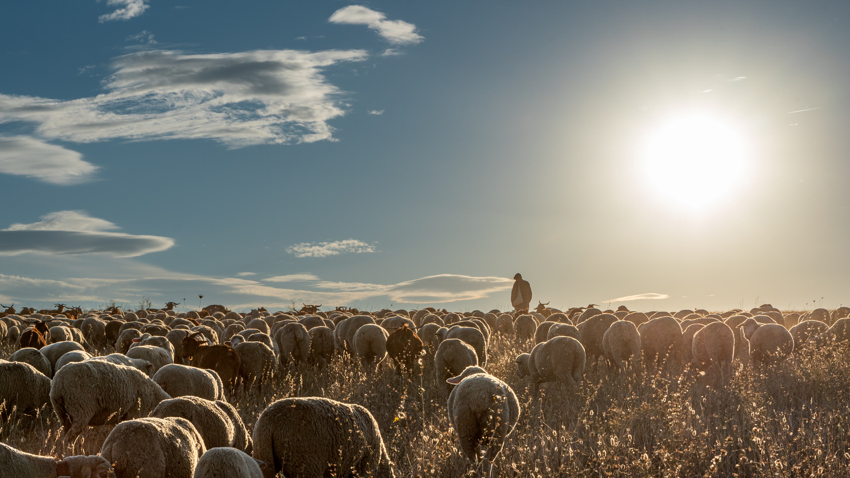
Sunday Toolkit
You have set a table for me
in the middle of everything that frightens me.
I am learning to sit down.
To let your love shower me.
To hold out my hands
and not move them away
when I doubt if I deserve what overflows.
FULL-OF-GRACE.COM

Slide 9
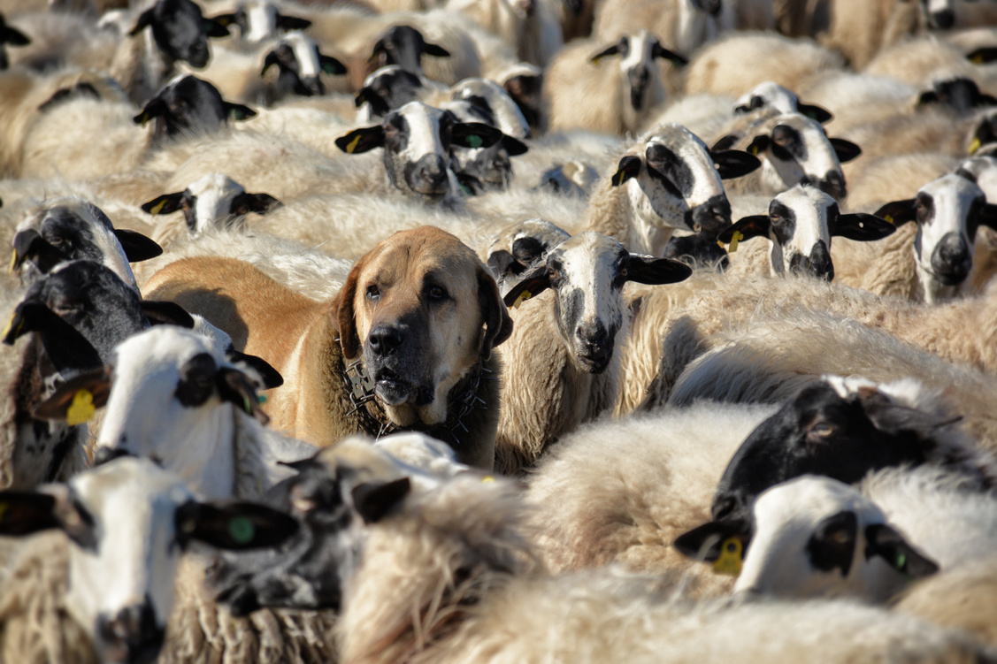
Sunday Toolkit
Goodness and mercy are following me
– I used to run from them,
thinking they were traps.
Now I recognise their sound.
FULL-OF-GRACE.COM

Slide 10
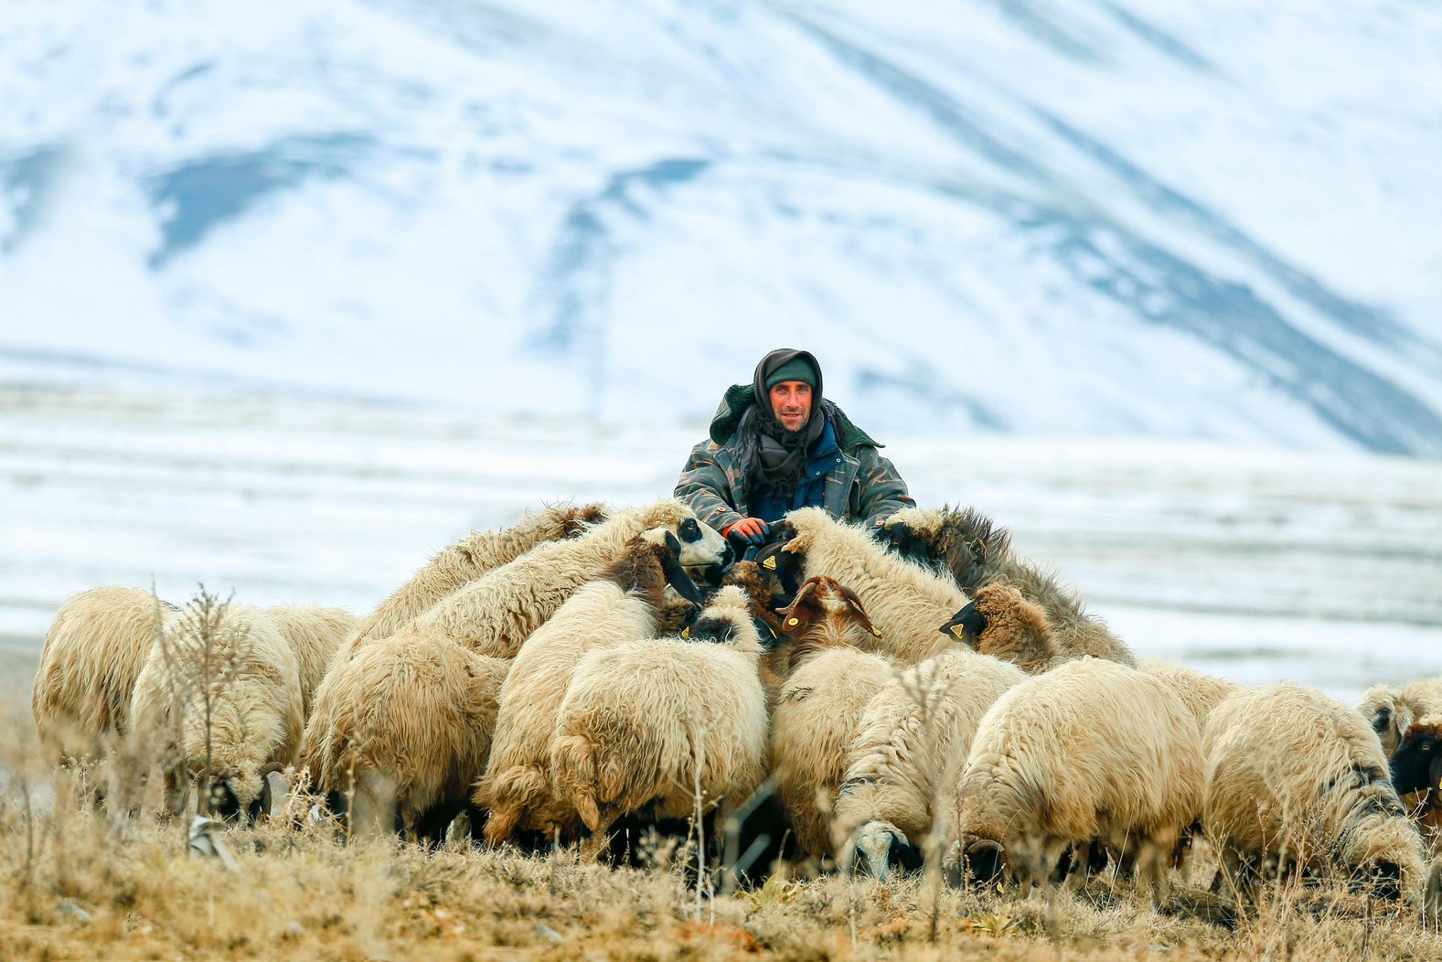
Sunday Toolkit
I will dwell
in the house of the Lord.
Not because I have earned the right to stay
but because
I have finally stopped leaving.
FULL-OF-GRACE.COM

